Slide 1




Rescuing penguins with Rust
Julien Faixo – July 2022 @jfaixo
Notes:
Objectifs:
Promo de Rust
Sensibiliser à l’impact ND des décisions de conception

Slide 2
Agenda
What can we do for the penguins ?
What resources really impacts power consumption ?
Let’s talk about technology footprints
Rust to the rescue !
Rescuing penguins with Rust – Julien Faixo
Notes:
Nous humble développeurs => tuer la planète moins vite pour nos pingouins

Slide 3


What can we do for the penguins ?

Slide 4
Environmental Impact of Digital Technology in France
All criteria included : End user devices have the biggest impacts (63,6% to 92%) , followed by data centers, and networks
Fabrication/distribution/usage & eol: Fabrication have the biggest impact
Regarding usage, impacts mainly come from power consumption
Source: Evaluation de l’impact environnemental du numérique en France et analyse prospective, Arcep
Rescuing penguins with Rust – Julien Faixo
Notes:
A notre niveau de développeurs logiciels, que peut-on faire ?
Ne pas oublier que notre code ne tourne pas dans la matrice
Essayer de minimiser la fabrication de matériel (nouveau, actualisation)
Essayer de maximiser l’efficacité énergétique (en faire plus pour moins)
Un premier niveau d’analyse montre que les terminaux « utilisateur » sont responsables de la majorité des impacts pour chaque indicateur (entre 63,6% et 92% des impacts), suivi par les centres de données et les réseaux (respectivement entre 4% et 22,3%, et entre 2% et 14 %). Un second niveau de distribution d’impact est présenté selon les phases du cycle de vie (fabrication, distribution, utilisation et fin de vie). Ces résultats montrent que la phase de fabrication est la principale source d’impact pour les trois tiers, suivi de la phase d’utilisation ce qui confirme l’importance des politiques visant à allonger la durée d’usage des équipements numériques à travers la durabilité des produits, le réemploi, le reconditionnement, l’économie de la fonctionnalité ou la reparation
Concernant l’utilisation, les impacts viennent majoritairement de la consommation d’électricité.

Slide 5
Some challenges
Limit the renewal of equipment as much as possible
Frontend: Prioritize User Experience
Backend: Design for performance
Increase computational density
Optimize resources usage
Minimize resources consumption of jobs
Rescuing penguins with Rust – Julien Faixo

Slide 6

What resources really impacts power consumption ?

Slide 7
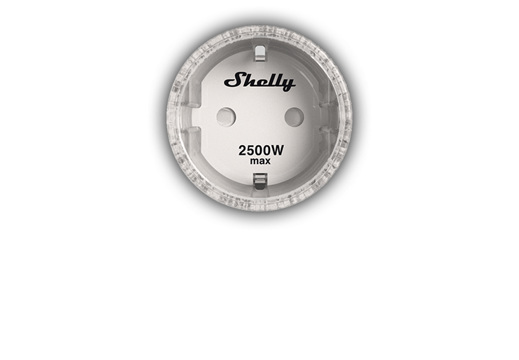
Let me introduce you to Shelly
Shelly Plug S
Wifi operated plug
Standalone
Power measurement
HTTP & MQTT APIs
Rescuing penguins with Rust – Julien Faixo
Notes:
Standalone: lots of nice features (scheduling, power throttling, small web server, integrations, cloud...)

Slide 8
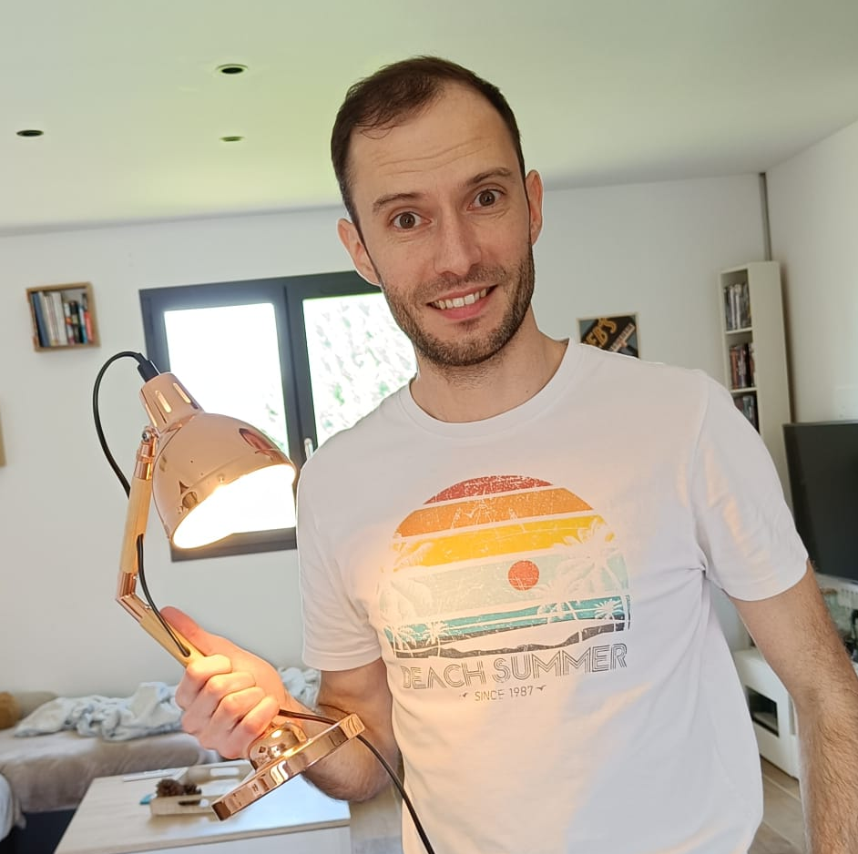
A light bulb 💡
Theoretical input power
2 W
Shelly said: "2.06 W"
Rescuing penguins with Rust – Julien Faixo

Slide 9
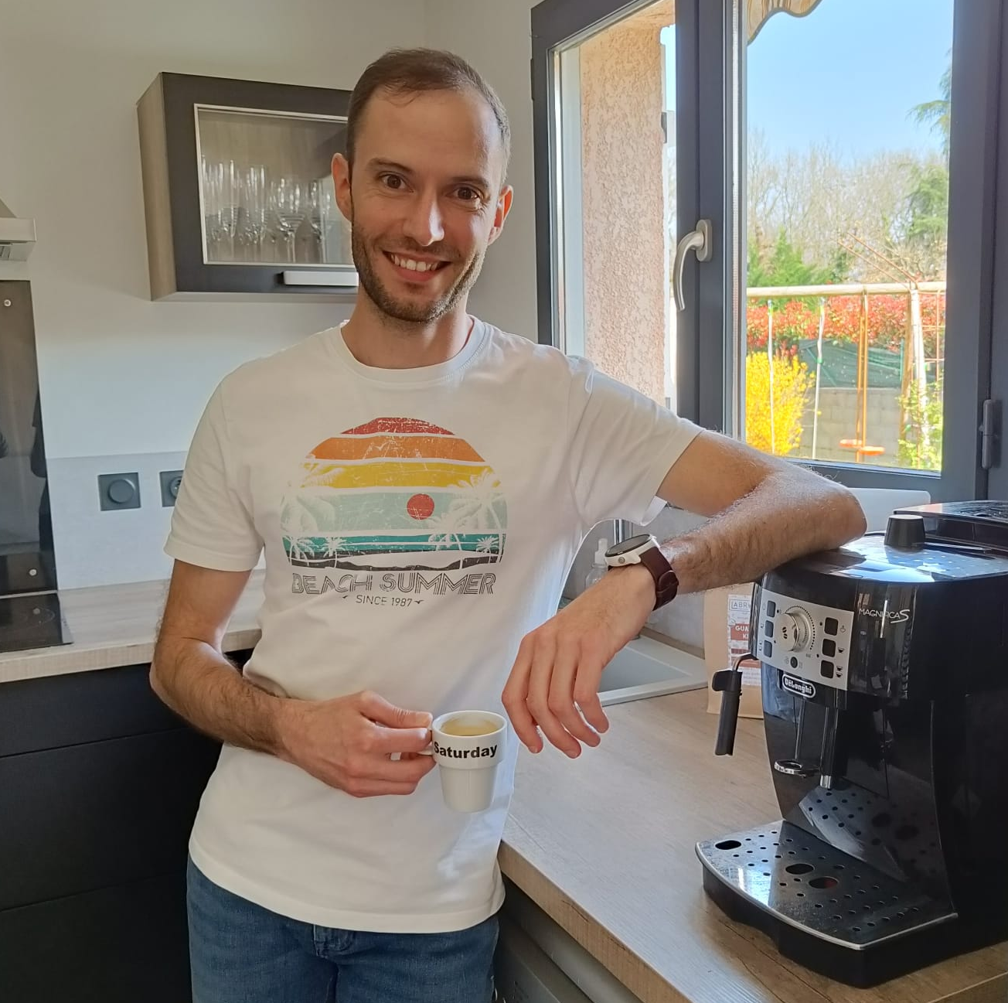
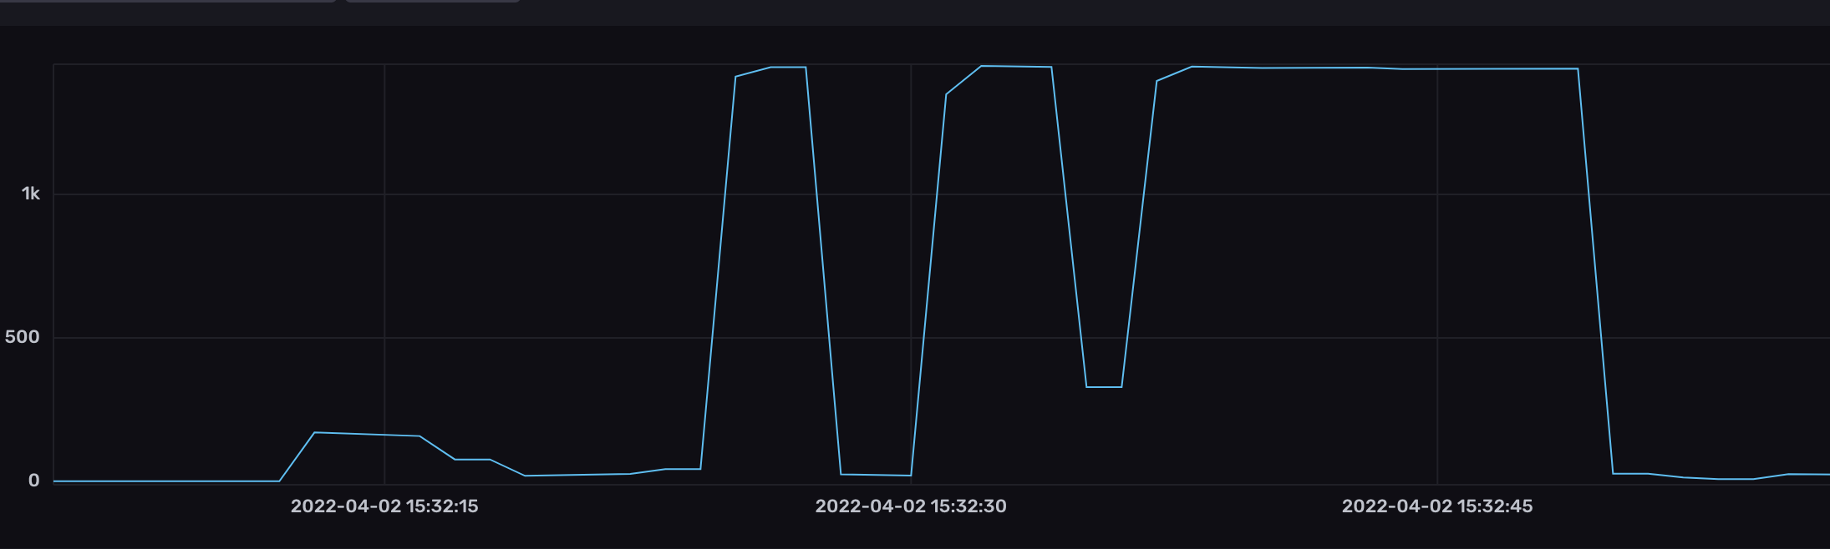
My coffee machine ❤
Theoretical input power
1450 W
Shelly flashed it at 1444 W
Rescuing penguins with Rust – Julien Faixo
Notes:
~25sec pour faire un café
Détecter ce pattern temporel pour compter le nombre de café que je me fais par jour (ma machine n’étant pas connectée)
Là vous devez vous dire que ce mec a beaucoup trop de temps libre

Slide 10
The measuring setup
Telegraf
Retrieve system metrics
Send to InfluxDB
InfluxDB
Store metrics
Allow to query
Data visualization
Eth
Raspberry Pi 4
Router
Gigabit ethernet
Wifi
Eth
Telegraf
Retrieve Shelly metric
Send to InfluxDB
Wifi
Shelly
Measure power consumption
PC
Rescuing penguins with Rust – Julien Faixo

Slide 11
The measuring setup
Telegraf
Retrieve system metrics
Send to InfluxDB
InfluxDB
Store metrics
Allow to query
Data visualization
Send
Raspberry Pi 4
Router
Gigabit ethernet
Wifi
Send
Measure
Telegraf
Retrieve Shelly metric
Send to InfluxDB
Shelly
Measure power consumption
Fetch
PC
Rescuing penguins with Rust – Julien Faixo

Slide 12

Let’s make some measures !
Rescuing penguins with Rust – Julien Faixo
Notes:
Mea culpa :
j’étais chaud pour le faire en live
je l’ai foiré une fois, réussi une fois, roulette russe
Mais pas live aujourd’hui, tout essayé, réseau entreprise ne le permet pas

Slide 13
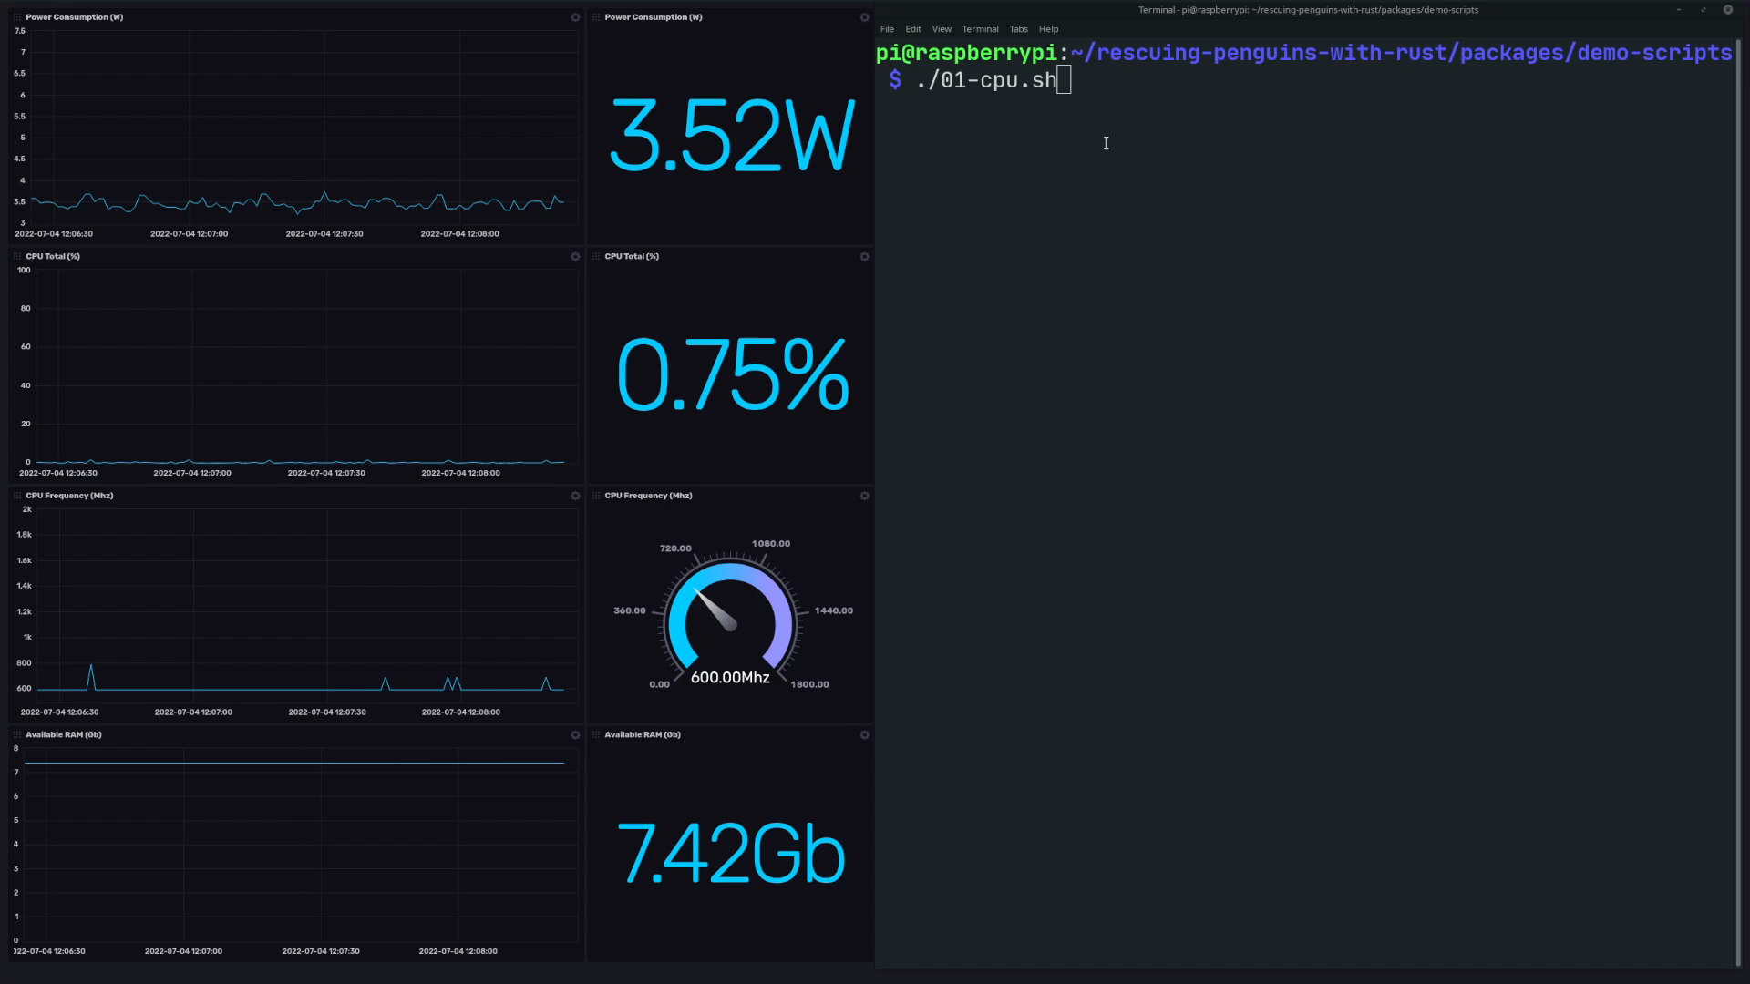
Notes:
Présenter la partie gauche
Script a droite : stress, utilitaire linux qui stresse X cpu (4 coeurs sur le raspberry 4)
Observations:
Fréquence augmente direct
Escalier suivi par la conso, avec une 1ère marche plus haute
Fun fact: stress => boucle infinite sur racine

Slide 14
Some takeaways about power consumption
CPU: Depends on load of each core
Idle ~> Halt until next interrupt
DVFS: Dynamic Voltage and Frequency Scaling
Rescuing penguins with Rust – Julien Faixo

Slide 15
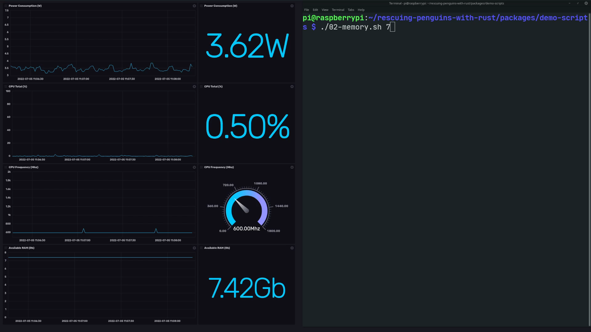
Notes:
Objectif: voir si l’état de la mémoire (0 ou 1) impacte la conso (un 1 == un condensateur chargé == conso ?)
Fun fact: optimisation du cas de l’init de page mémoire à 0

Slide 16
Some takeaways about power consumption
CPU: Depends on load of each core
Idle ~> Halt until next interrupt
DVFS: Dynamic Voltage and Frequency Scaling
RAM: State does not affect consumption
Memory cells keep skrinking, so do their input voltage
DRAM Memory refresh have a huge impact ^{[1]}
[1] What Every Programmer Should Know About Memory
Rescuing penguins with Rust – Julien Faixo

Slide 17
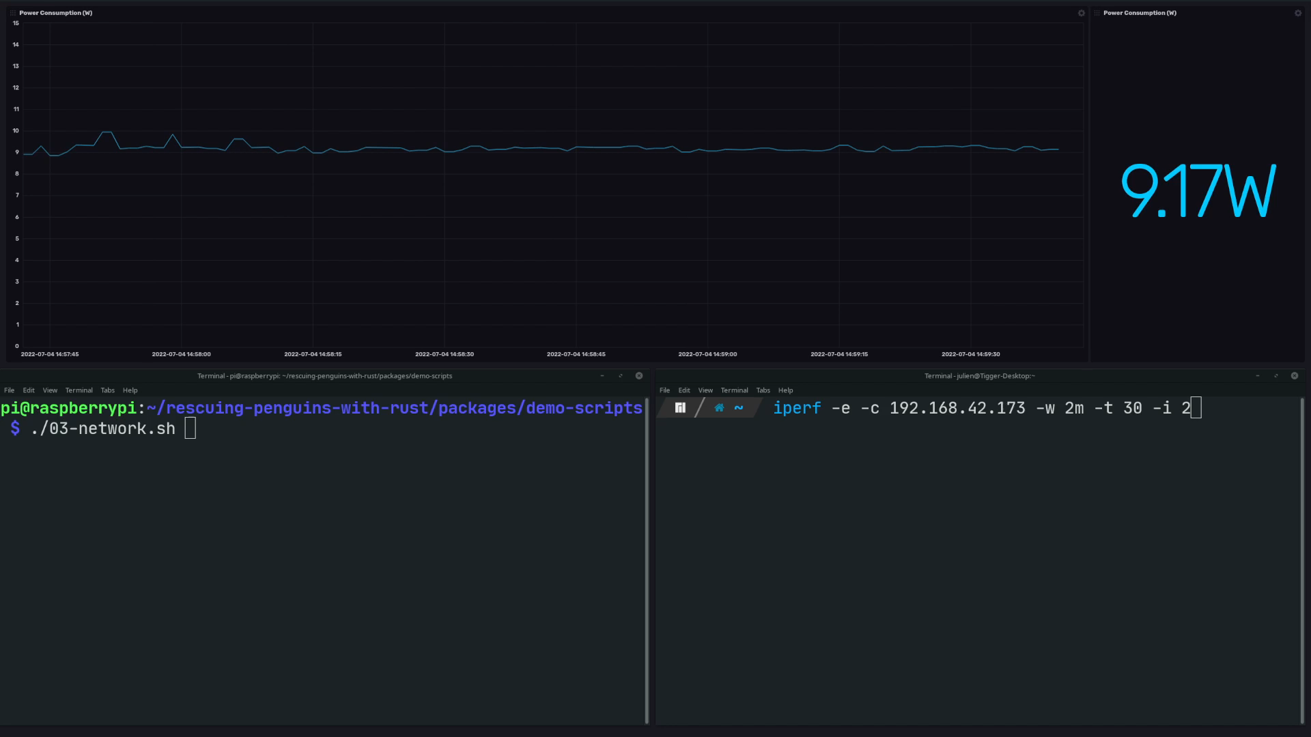

Slide 18
Some takeaways about power consumption
CPU: Depends on load of each core
Idle ~> Halt until next interrupt
DVFS: Dynamic Voltage and Frequency Scaling
RAM: State does not affect consumption
Memory cells keep skrinking, so do their input voltage
DRAM Memory refresh have a huge impact ^{[1]}
Network: Constant consumption, no matter the load
Reducing your bandwidth consumption will have 0 effect on the network infrastructure power consumption ^{[2]}
[1] What Every Programmer Should Know About Memory [2] Mesurer le CO2 selon les gigaoctets consommés : l’idée qui consterne le secteur du numérique
Rescuing penguins with Rust – Julien Faixo

Slide 19

Let’s talk about technology footprints

Slide 20
The dumb test
GET /?name=world
Response: Hello world
Implemented with
Node + Express
Node + Express clustered
Node + Fastify
Node + Fastify clustered
Java + Vert.x clustered (with Kotlin)
Rust + Actix
Rescuing penguins with Rust – Julien Faixo

Slide 21
Let’s make some measures !
Rescuing penguins with Rust – Julien Faixo

Slide 22
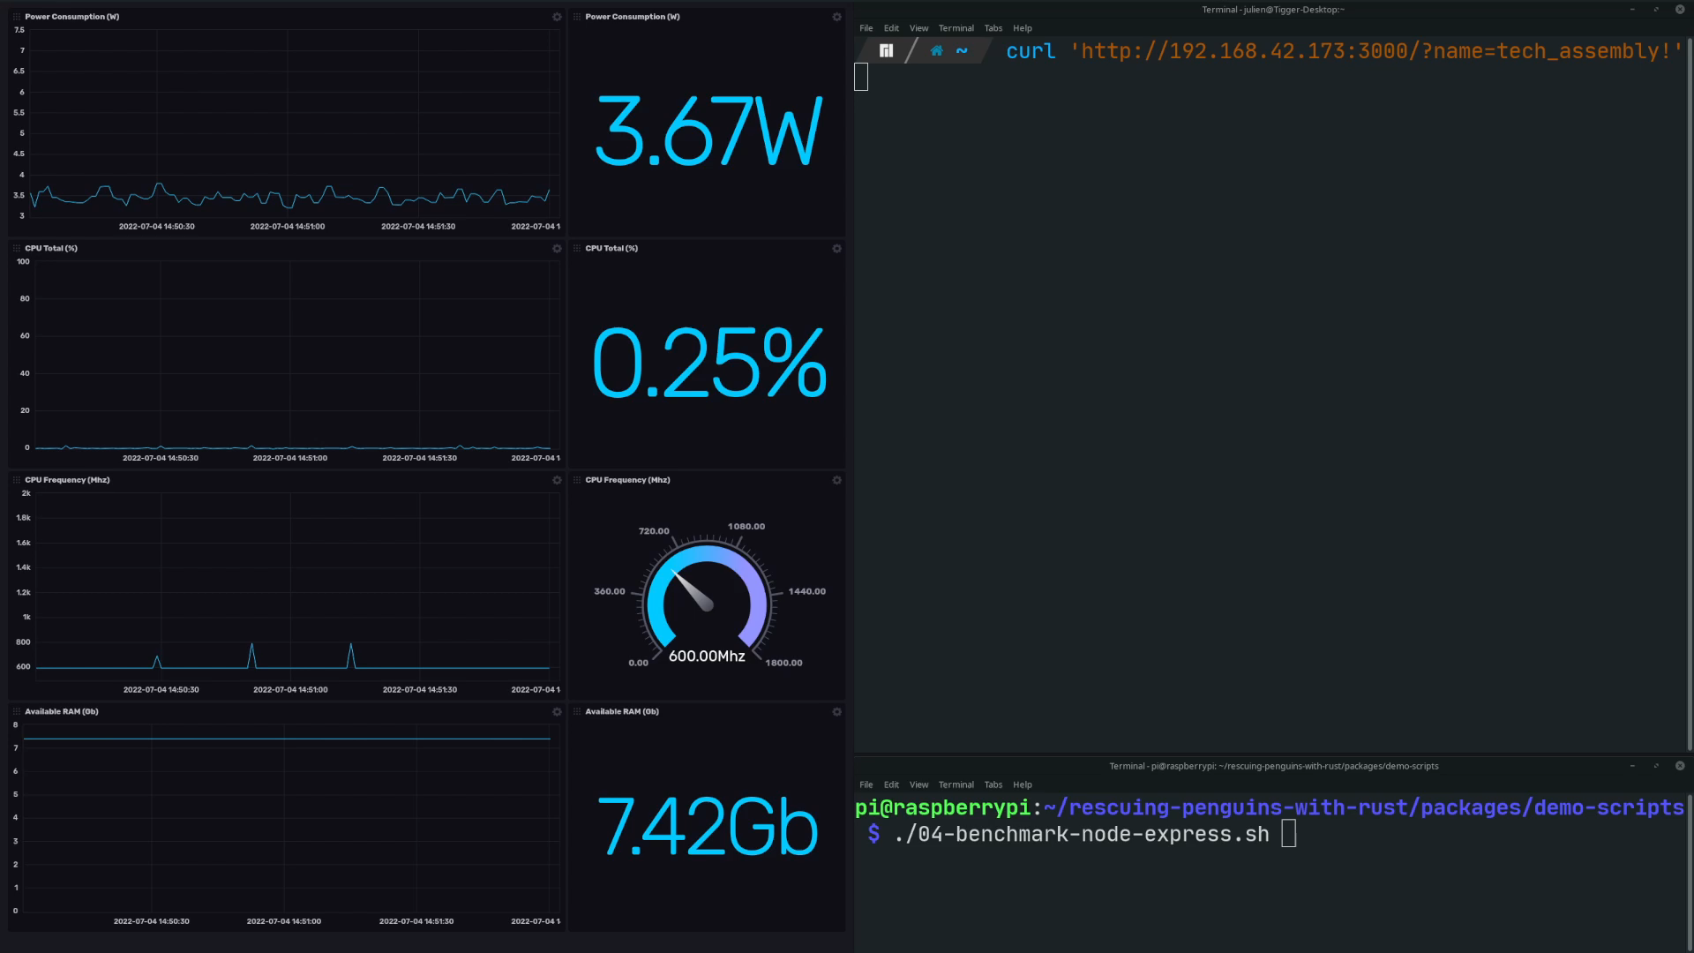
Notes:
NodeJS + Express

Slide 23
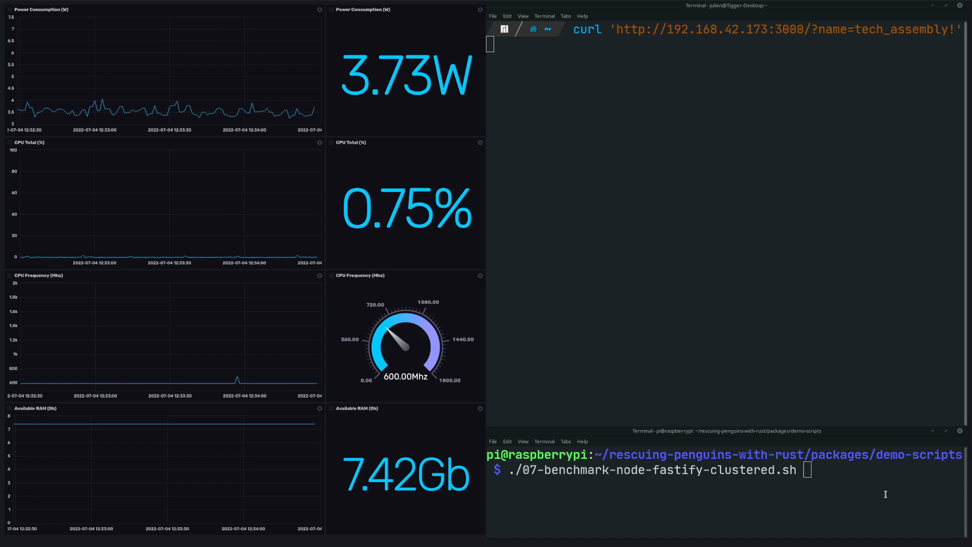
Notes:
NodeJS + Fastify clustered

Slide 24
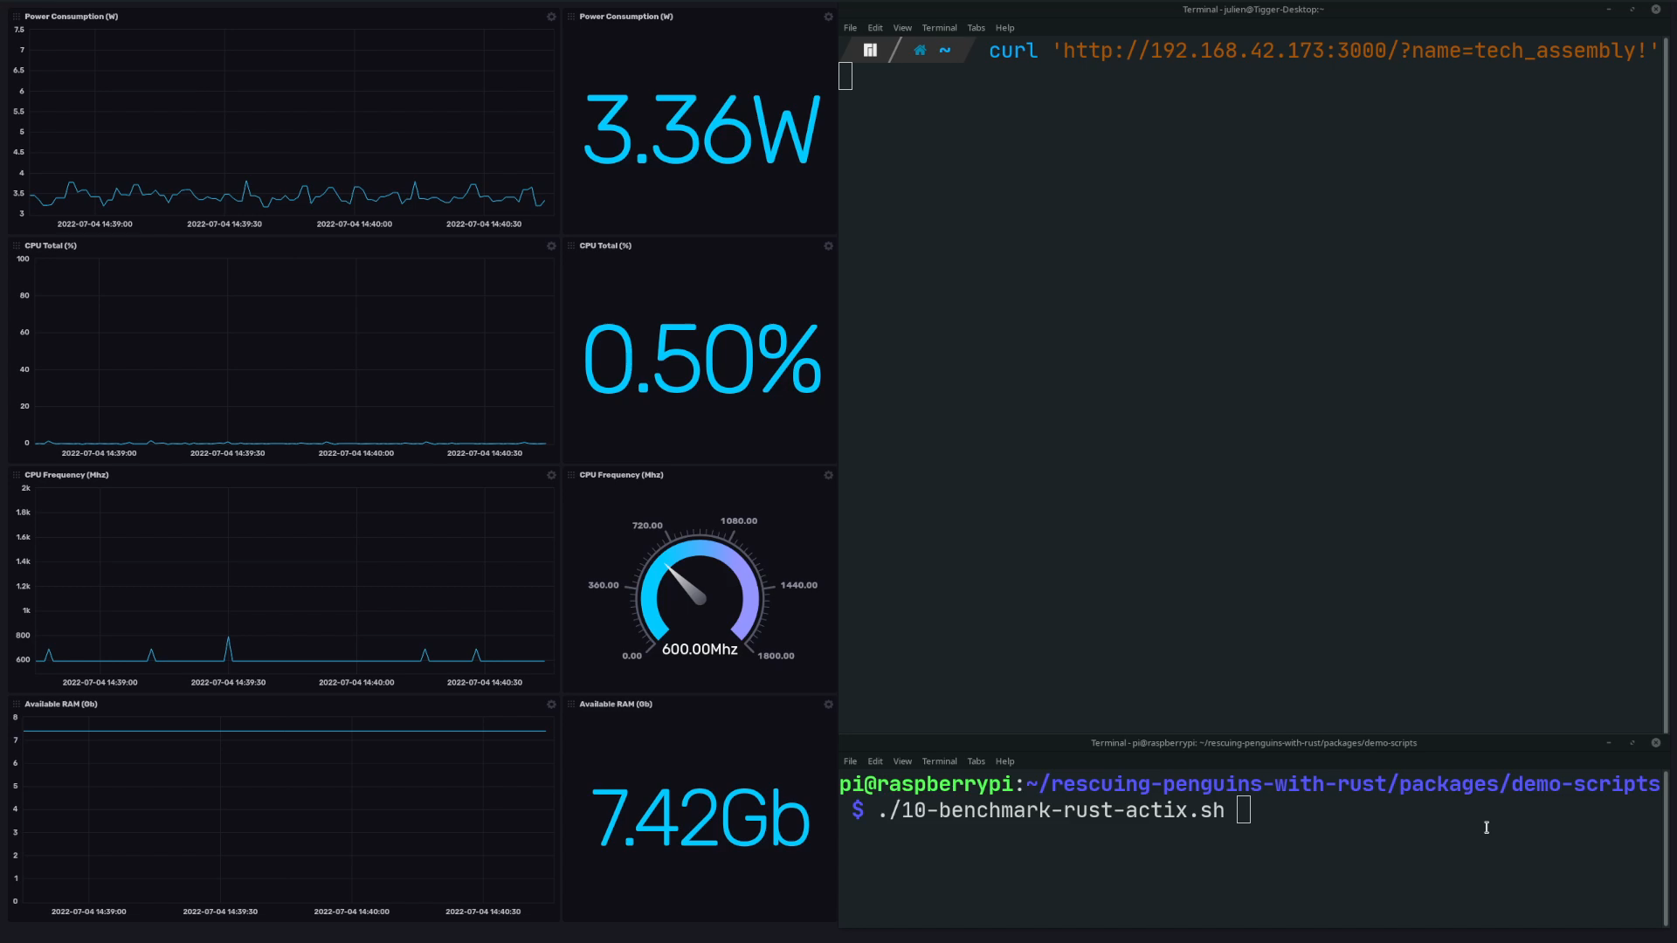
Notes:
Rust Actix

Slide 25
Results
Rescuing penguins with Rust – Julien Faixo

Slide 26
Results
Rescuing penguins with Rust – Julien Faixo

Slide 27
Results
Rescuing penguins with Rust – Julien Faixo

Slide 28
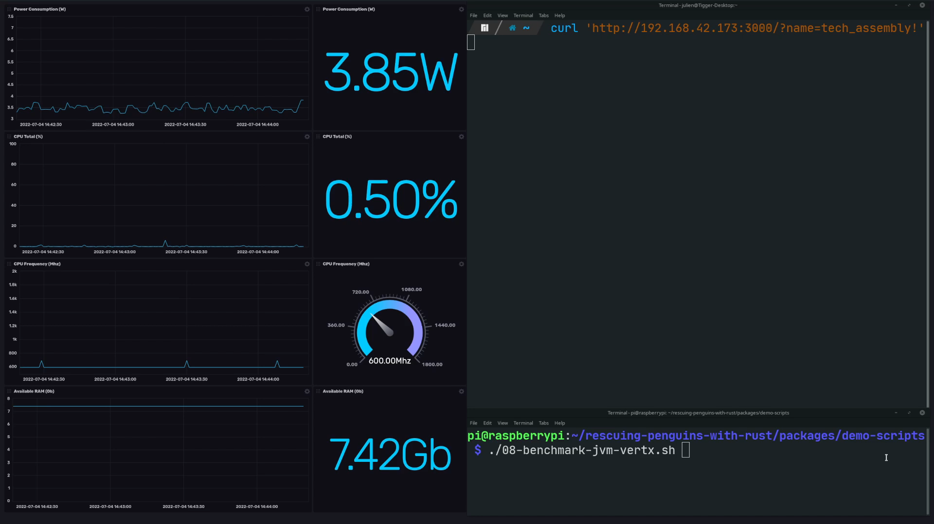

Slide 29
Some takeaways about technologies
Performance varies significantly across technologies
In order to reach the same operational requirements, hardware requirements may be significantly higher
More hardware to build
More power consumption
Rescuing penguins with Rust – Julien Faixo

Slide 30
Some takeaways about technologies
In a cloud context, you pay what you use
Efforts regarding performance will probably result in cost reduction
In a Kubernetes context, lighter pods means more pods per node
May lower the number of required nodes
On old hardware, may help to keep software running smoothly
Use all the value of hardware
Rescuing penguins with Rust – Julien Faixo

Slide 31
Ok, Java is not that far away, but...
This use case is voluntarily simple, a more computational one would have widened the gap
There is still a 6-7% gap
Warm up stats have been evicted => It takes ~15s to reach this level of throughput
Memory consumption cannot be compared
Binary size is bigger
It took me more time to reach this level of perf with Java than with Rust
Rescuing penguins with Rust – Julien Faixo
Notes:
Je vous entend au fond à dire que Java s’en sort pas mal du tout. C’est un talk sur Rust ici, on se calme, petit slide recadrage
Bien, maintenant que je vous ai bien chauffés, on continue
Rust: 2,7Mo vs Java: 9.4Mo

Slide 32
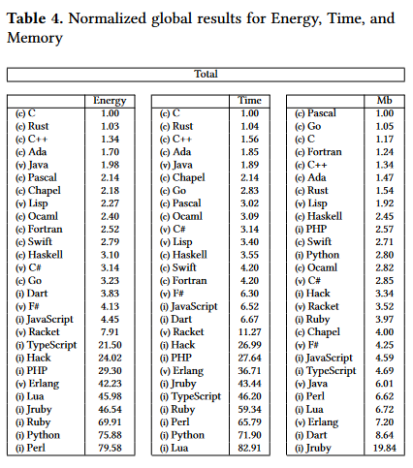
Energy Efficiency across Programming Languages
27 languages
10 benchmarking problems
Energy, execution time and peak memory consumption measures
Source: Energy Efficiency across Programming Languages
Rescuing penguins with Rust – Julien Faixo

Slide 33


Rust to the rescue !

Slide 34
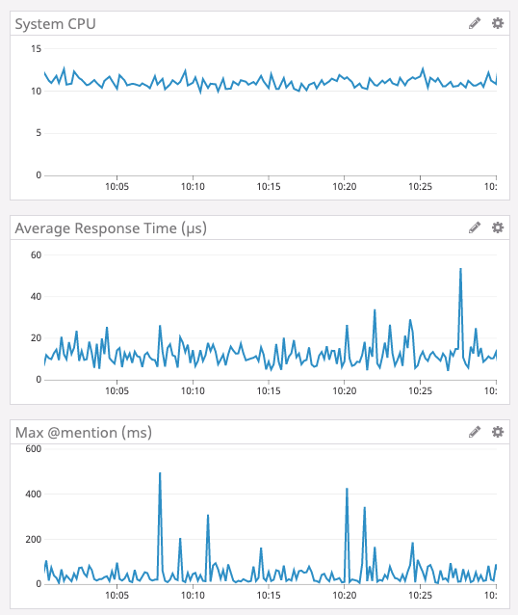
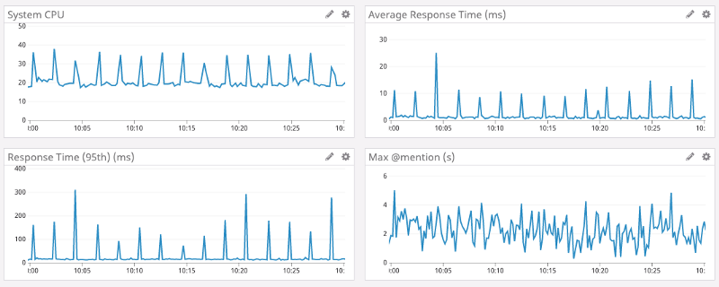
Some optimization stories
Discord
Had latency spike issues due to Go Garbage Collector
Go
Rust
Source : https://discord.com/blog/why-discord-is-switching-from-go-to-rust
Rescuing penguins with Rust – Julien Faixo

Slide 35
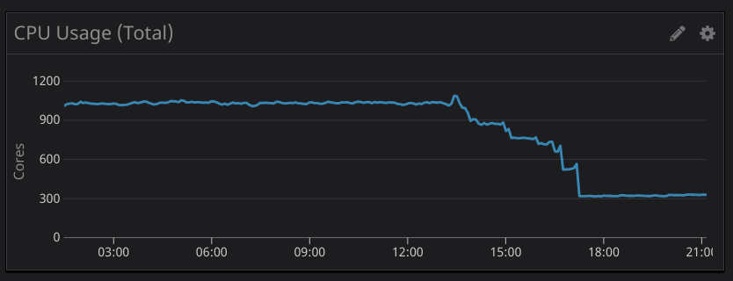
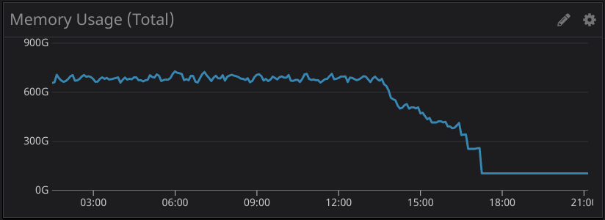
Some optimization stories
Tenable.io
Use a custom metrics filter in their datadog sidecar agent, originally written in Node. They had scalability issues with this filter, consuming more and more compute resource as their platform scale up.
Tenable rewrote it in Rust :
75% reduction in CPU
95% reduction in memory usage
50% faster
Raw save of 700 CPU and 300GB
Source : https://medium.com/tenable-techblog/optimizing-700-cpus-away-with-rust-dc7a000dbdb2
Rescuing penguins with Rust – Julien Faixo

Slide 36
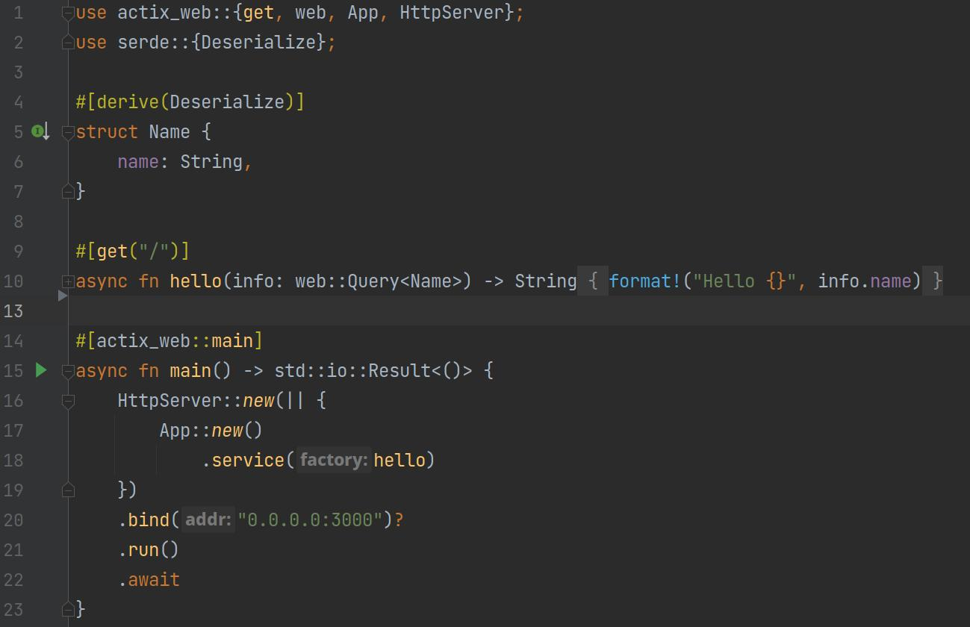
And the winner is...

Slide 37

Rust is hard to master… but to me, it’s worth it
Rust is harder to learn because you have to understand what you do
But in the end, you have :
A deeper understanding and control of your software ^{[1]}
Uncompromising performance
Reliability : Memory safety, thread safety, a demanding compiler
Productivity : Modern language, a “friendly” compiler
Rust brings answers to two of the challenges of the decade : sustainable IT, and cybersecurity
[1] If you want to go really deep: https://fasterthanli.me/
Rescuing penguins with Rust – Julien Faixo
Notes:
Entre 60% et 80% des vulnérabilités sont dues a des problèmes de memory safety

Slide 38

Thanks for them !

